Slide 1

A presentation on
IoT Based Remote Weather Controlling
Submitted To :-
Dr. Mukesh Gupta
Ms. Anjana Sangwan
Submitted By :-
Keshav Bhandari(17ESKCS079)
Department of Computer Science & Engineering
Swami Keshvanand Institute of Technology, Management and Gramothan, Jaipur
Rajasthan Technical University, Kota

Slide 2
Contents
Introduction
2. Tools and Technology used
3. Design
Project Details
4.1 | Objectives
4.2 | Modules
4.3 | Screenshots
5. Conclusion
6. Future Scope

Slide 3
INTRODUCTION

Slide 4
IoT based Remote Weather Controlling System is a project whose central task is to remotely monitor and control the weather conditions in order to maintain a specific required range of temperature and humidity.
The core idea of the project is to implement an intelligent and smart monitoring and controlling with less user interaction as possible.

Slide 5
Tools and Technology
Used

Slide 6
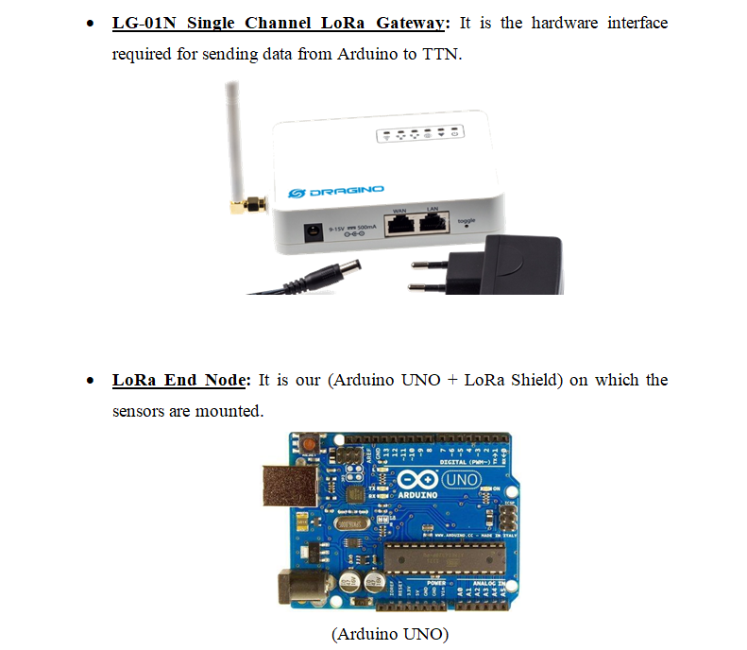

Slide 7
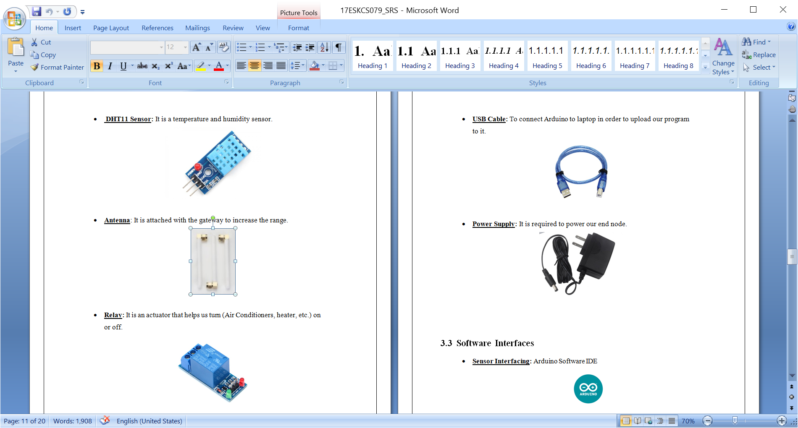

Slide 9
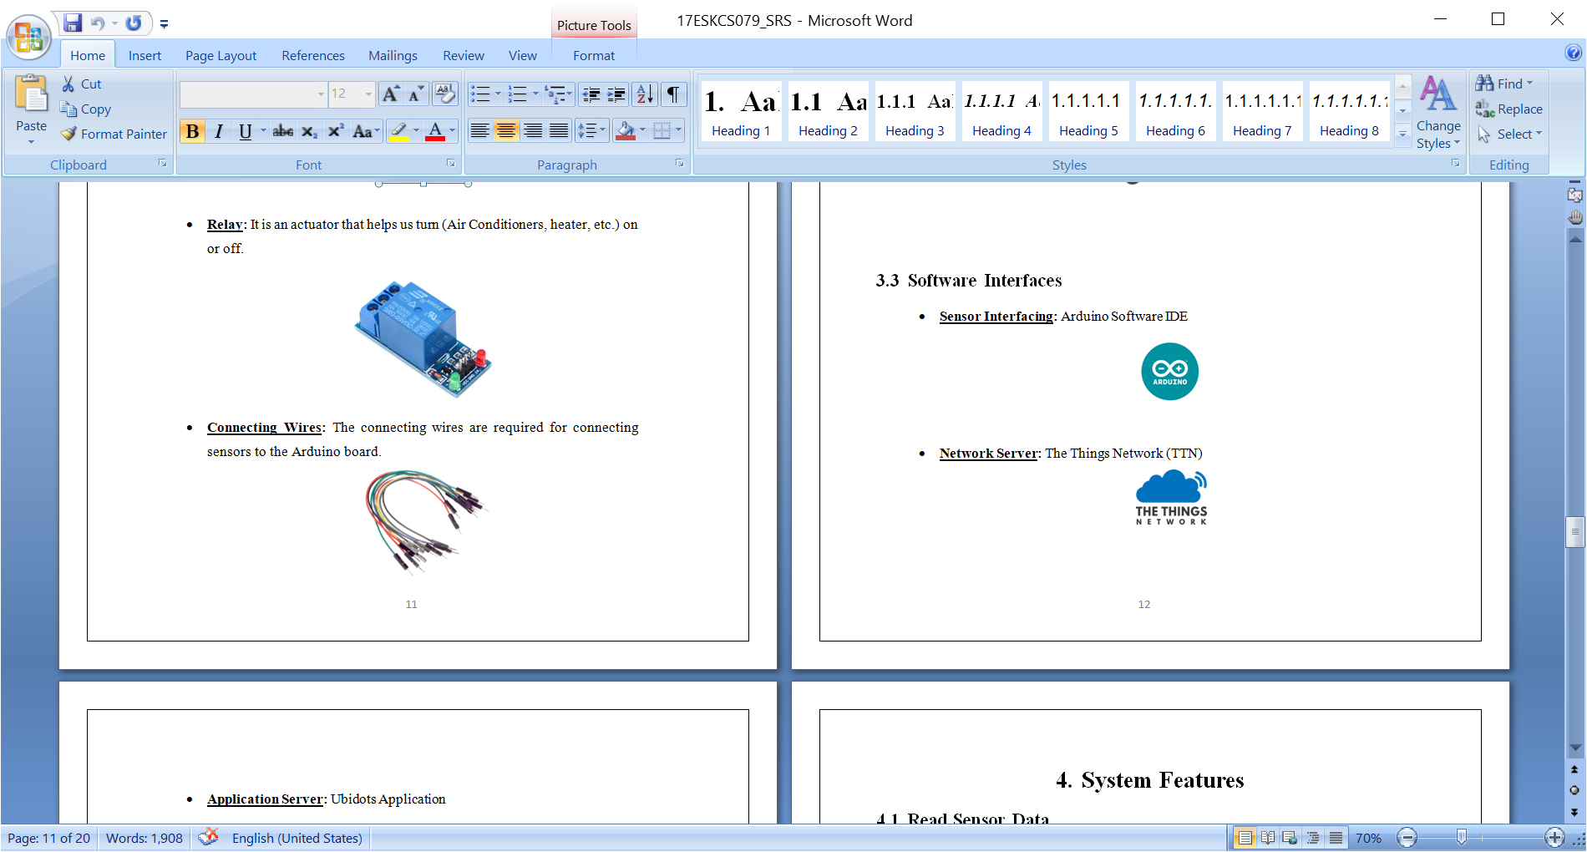
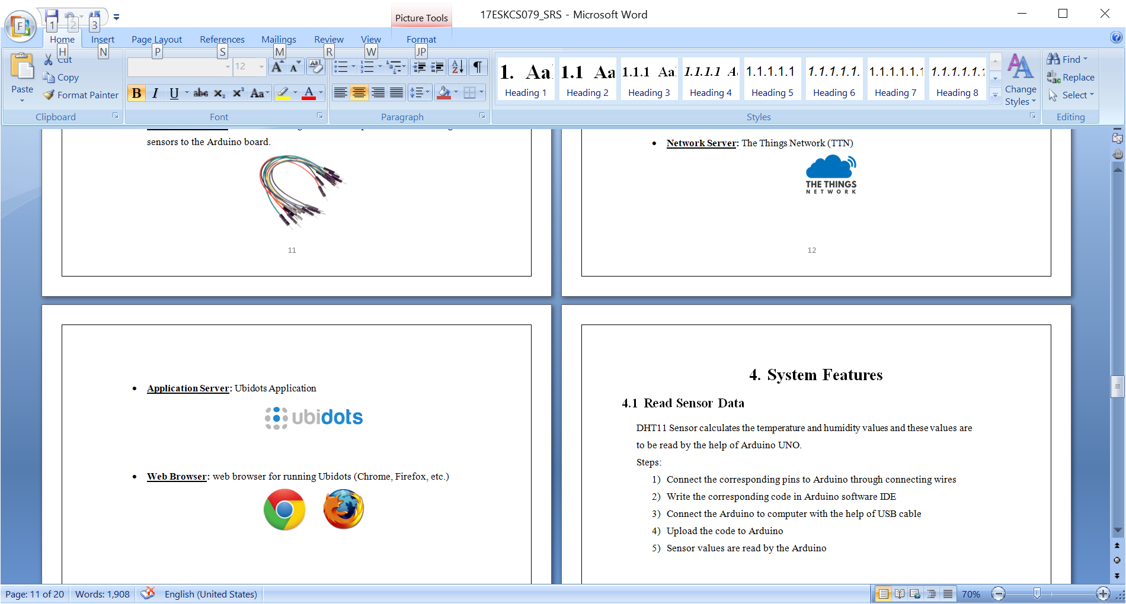

Slide 10
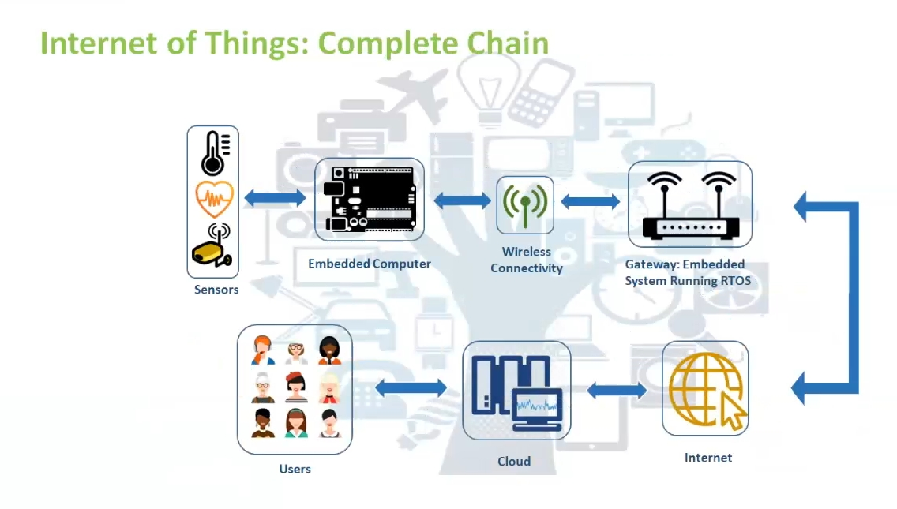
DESIGN

Slide 11
PROJECT DETAILS

Slide 12
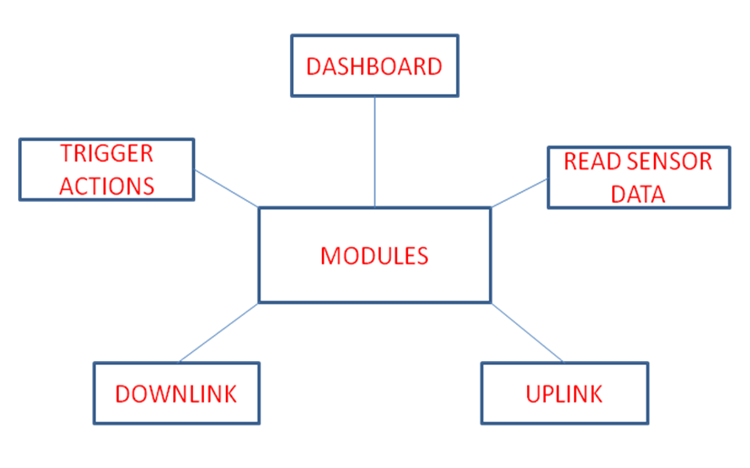
OBJECTIVES

Slide 13
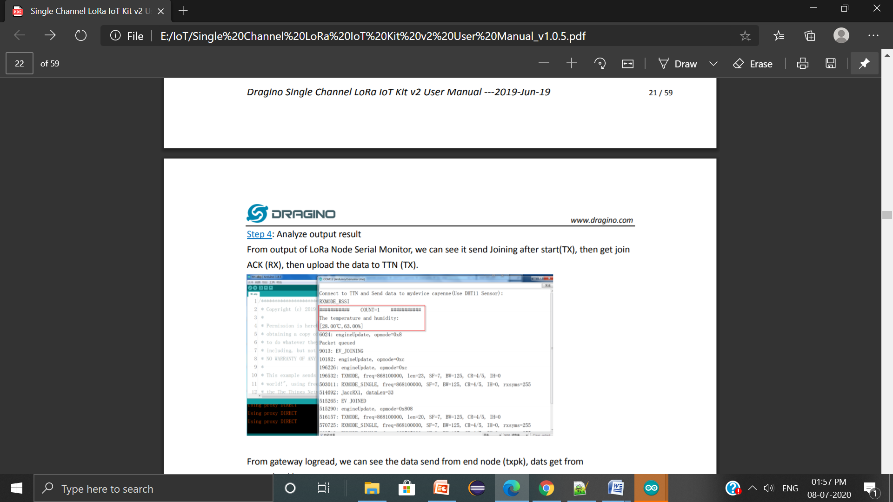
(Project Modules)
Read Sensor Data
DHT11 Sensor calculates the temperature and humidity values and these values are read by the help of Arduino UNO.
Connected the corresponding pins to Arduino through connecting wires
Wrote the corresponding code in Arduino software IDE
Connected the Arduino to computer with the help of USB cable
Uploaded the code to Arduino
Sensor values are read by the Arduino

Slide 14
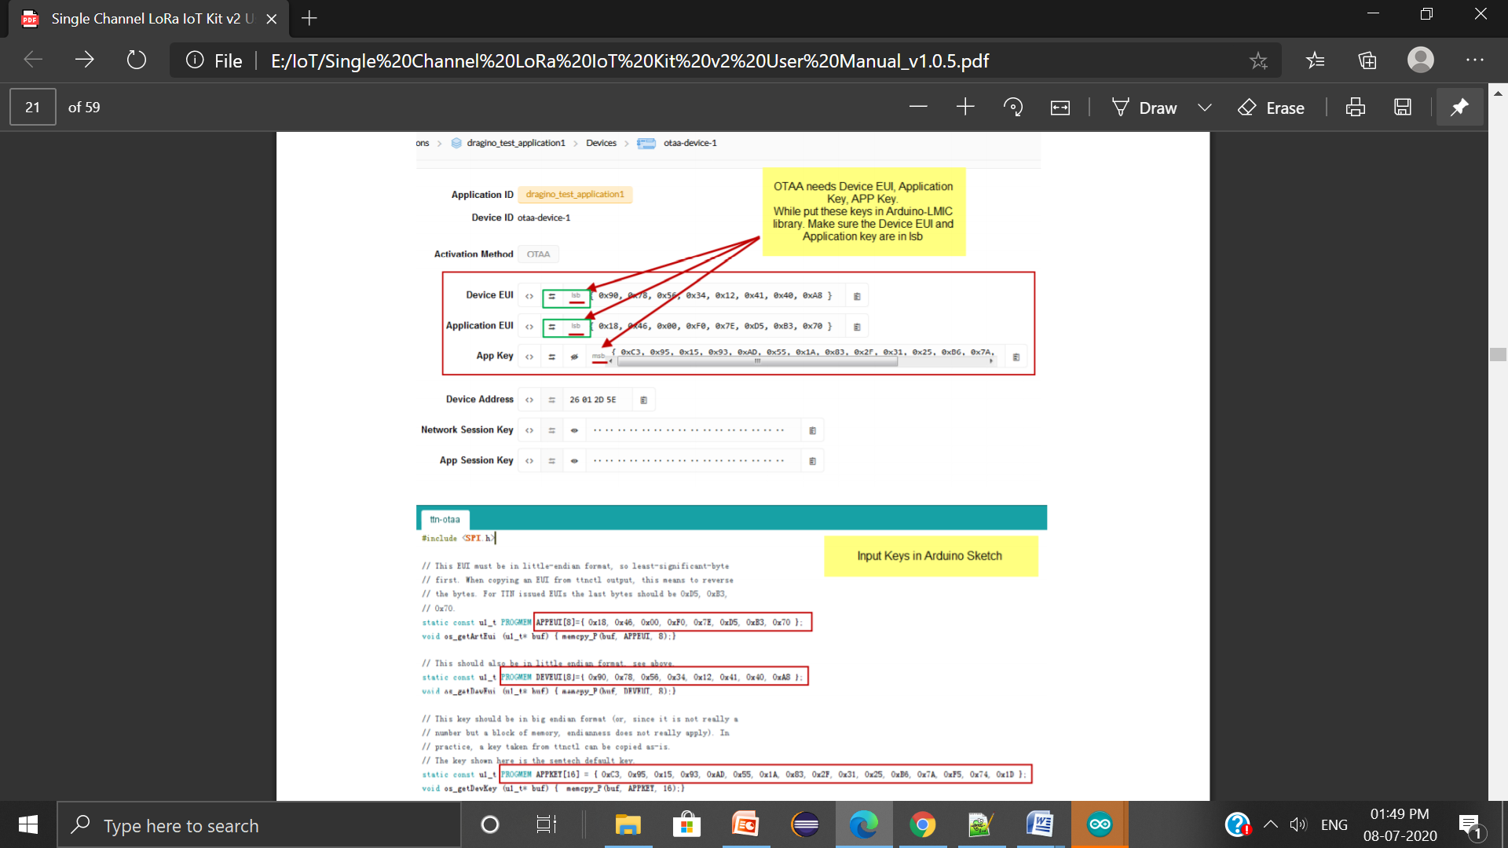
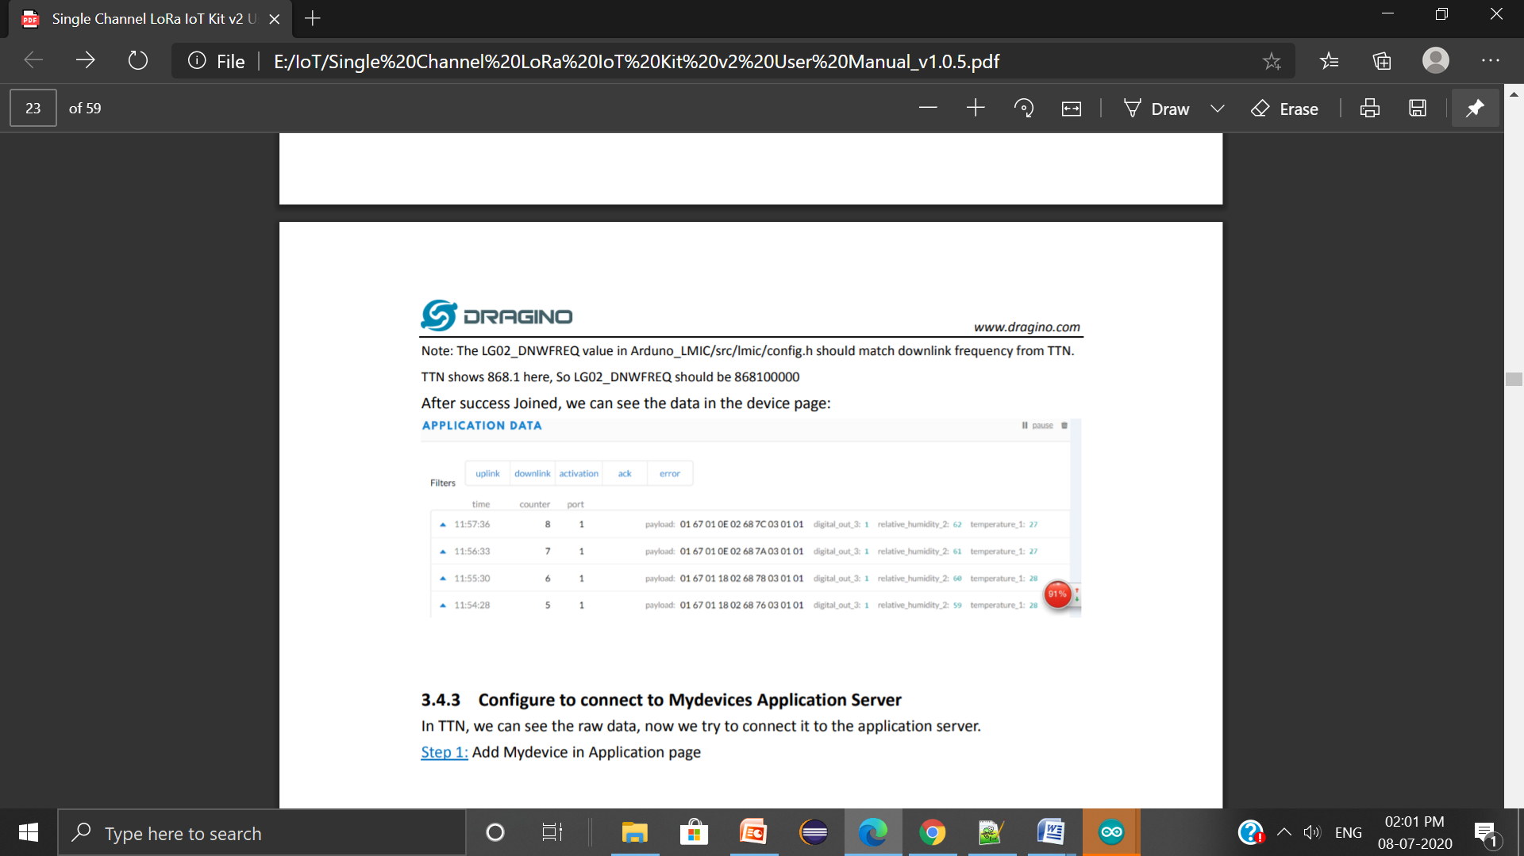
2) Uplink
The sensor values read by the Arduino sent to TTN and then to Ubidots with the help of LoRa shield.
Configure the gateway
Mount LoRa shield on Arduino for transmitting data to gateway
With the help of gateway, data sent to TTN
Wrote corresponding payload
Integrated TTN with Ubidots
Data sent to Ubidots

Slide 15
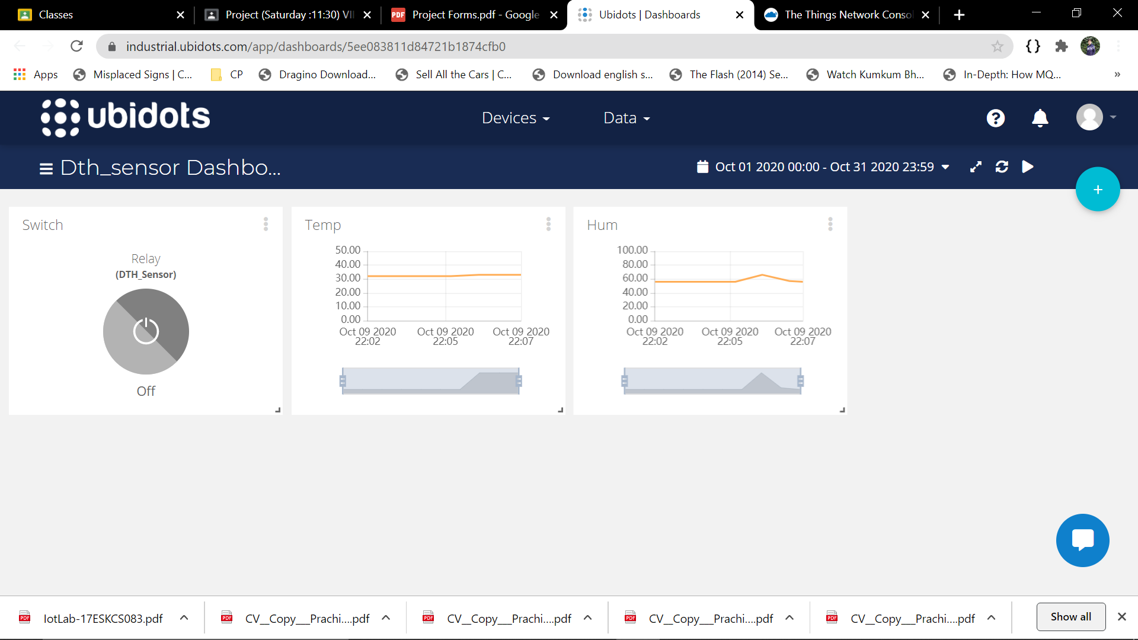
3) Dashboard
For monitoring the temperature and humidity in an efficient and user-friendly way, a dashboard is taken into account.
Created a new dashboard on Ubidots
Added our device on that
Added the corresponding parameters on the Dashboard
Added one relay on Dashboard for downlink
We can see our uploaded data on dashboard.

Slide 16
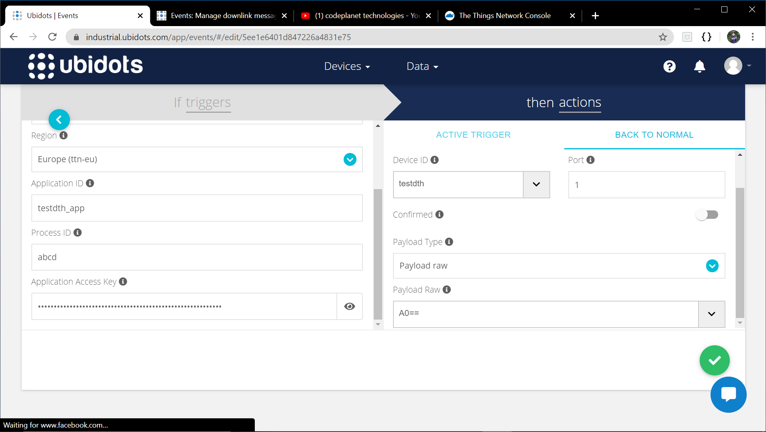
4) Trigger Actions
In order to control and maintain our required temperature and humidity range, we need to trigger our relay.
Create events in Ubidots
Select the variables for triggering actions
Set the ‘if’ conditions for specifying when the action to be triggered
Set what action to be performed in case ‘if’ condition satisfies
Set when to get back to normal conditions
Based on above triggering, relay is turned on or off

Slide 17
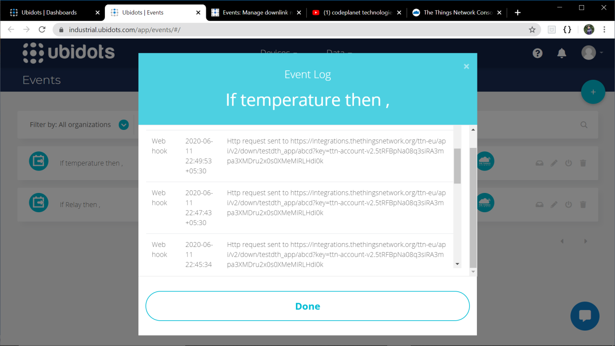
5) Downlink
In order to turn on or off the relay, downlink needs to be sent that gives the end node a message to turn it on or off.
When trigger event occurs, downlink is sent
How the end node respond to different downlinks is set
The downlink is confirmed
Action corresponding to given downlink is performed

Slide 18
SCREENSHOTS
Of
Project

Slide 20
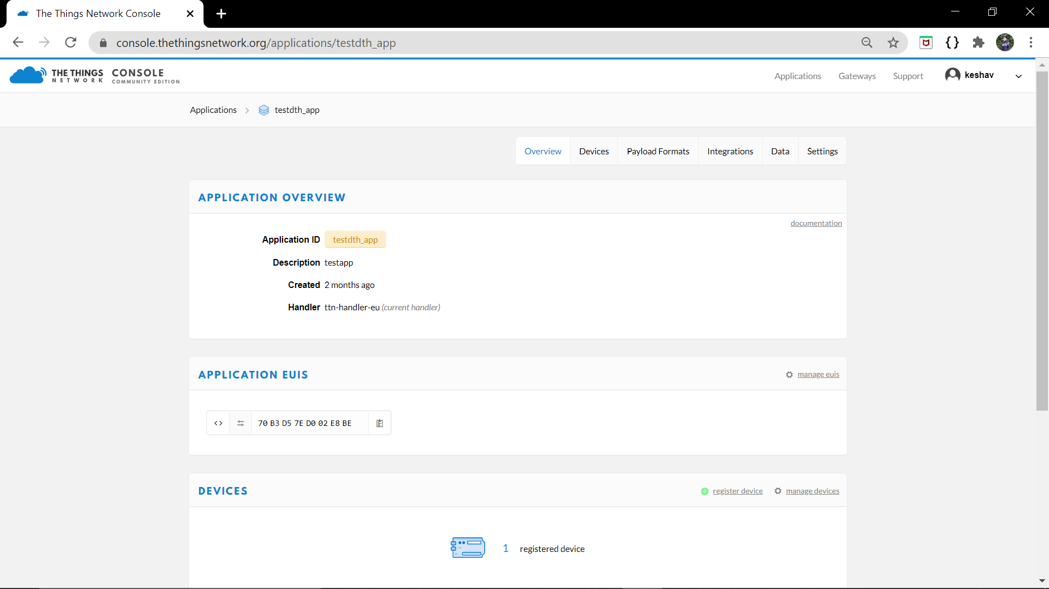
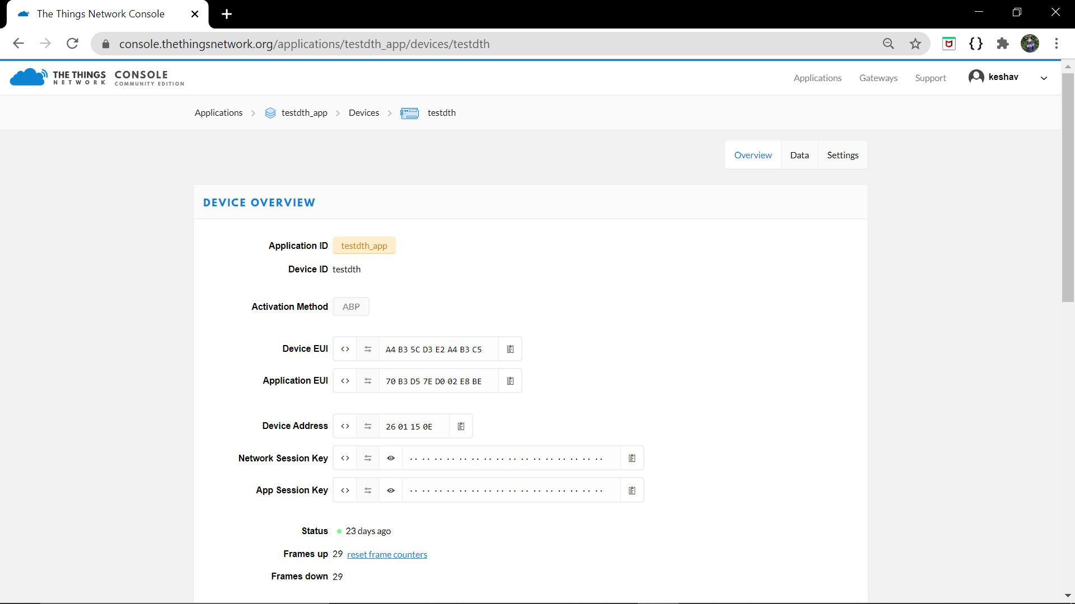

Slide 21
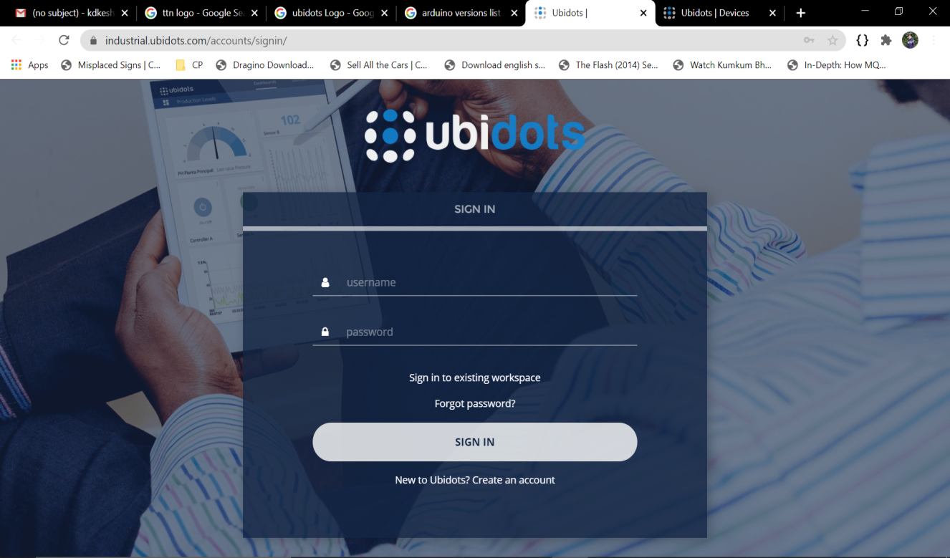

Slide 22
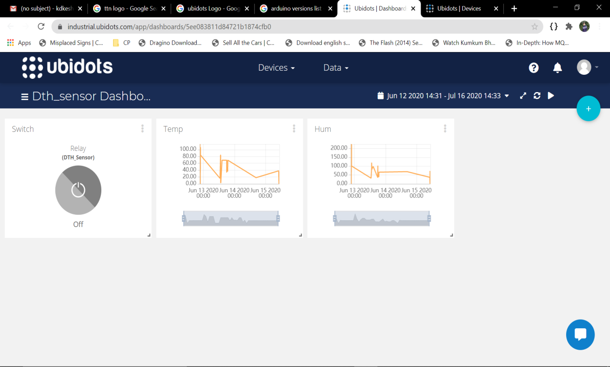

Slide 23
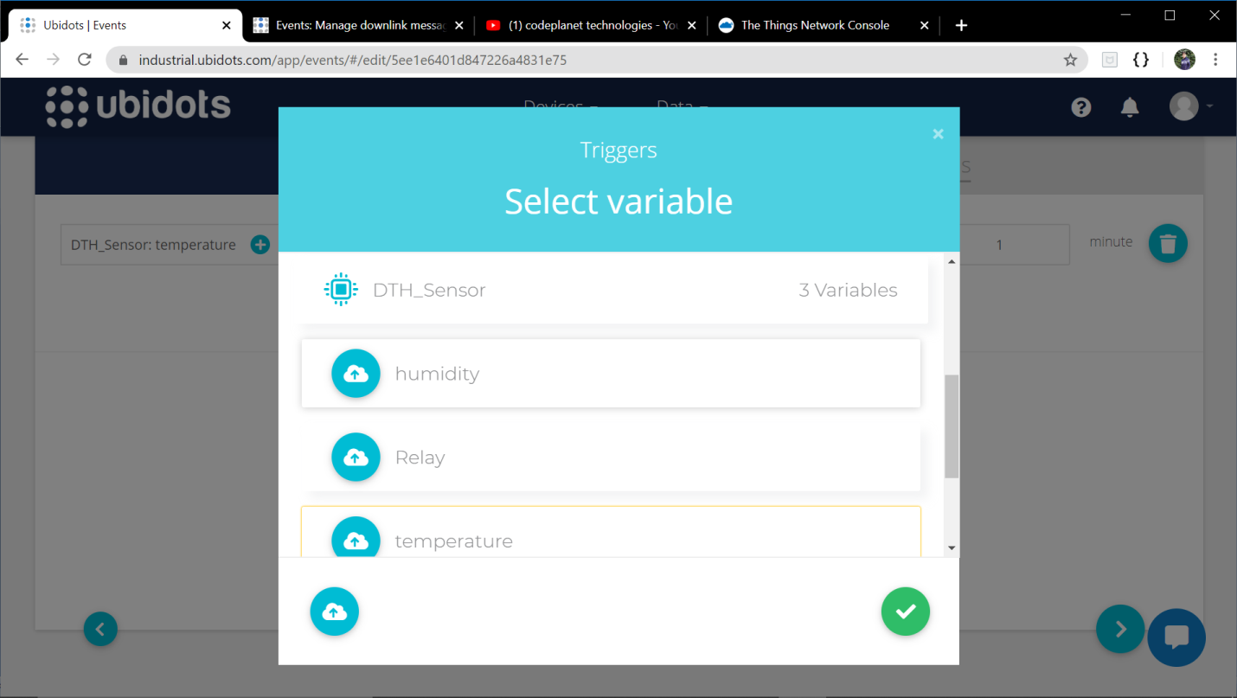
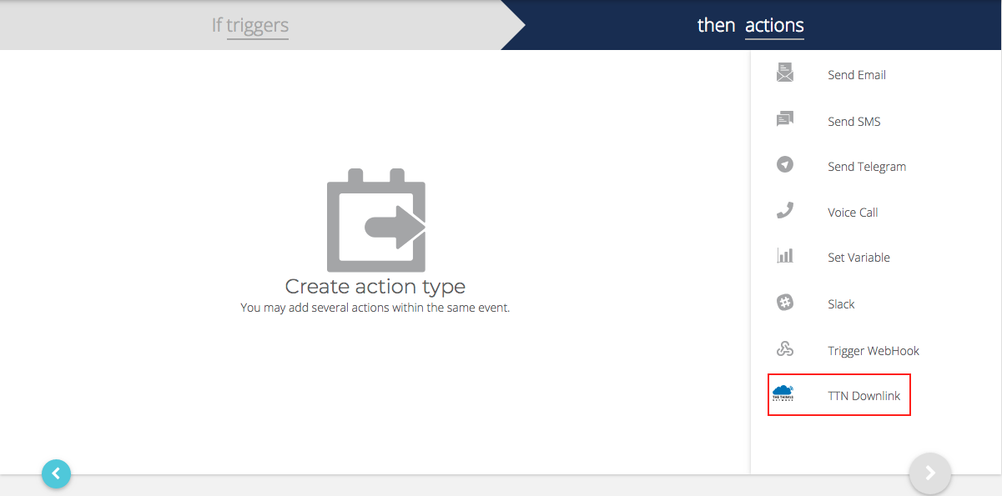

Slide 25
CONCLUSION
The project is considerable with a good number of parameters.
Here are some parameters that describe the purpose of how this project can handle real-time issues and provide efficient solutions for them.
• Automation and Digitalization: Automation is done which reduces required human resource with an ideal solution providing remote monitoring and controlling.
• Risk Minimization: It eradicates the risk of accidents that may occur in case the temperature and humidity conditions are not met.

Slide 26
FUTURE SCOPE
IoT based Remote Weather Controlling System will use Arduino sensors to detect temperature and humidity.
It updates the sensor values at regular intervals and based on that turn on or off the relay devices (air conditioners, heaters, etc.) in order to maintain the condition range with least interaction with user.
The project covers:
• Remote Sensing • Remote Monitoring
• Automation • Event Based Action Triggering
• Large Area Covering through LoRa.
This project has a wide scope of application. Applicable in Industries, Hospitals, Storage-houses, Home, Swimming pools, Oven, etc.

